Slide 1
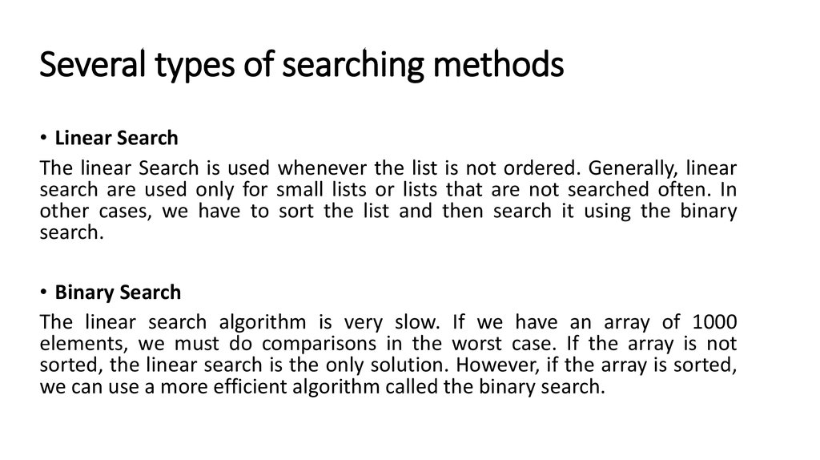

Slide 2
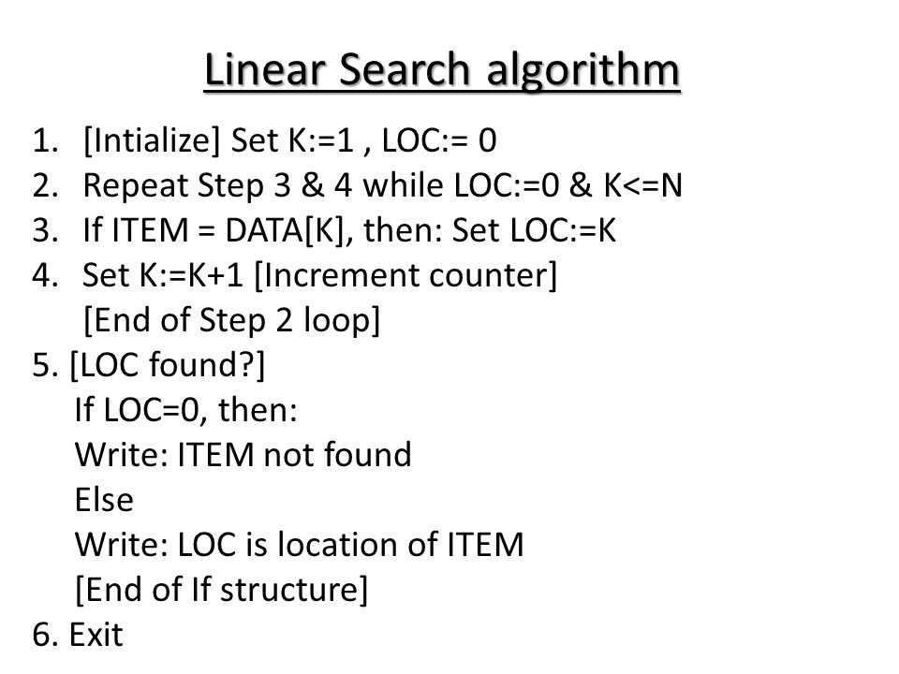

Slide 3
Binary Search Algorithm
Set BEG:=LB, END:=UB
MID=INT(BEG+END)/2
2. Repeat Steps 3 and 4
while(BEG<=END && DATA[MID]!=ITEM)
3. If(ITEM<DATA[MID] then END:=MID-1
Else BEG:=MID+1
[End of If]
4. Set MID=INT(BEG+END)/2
[End of Step 2 loop]
5. If DATA[MID]==ITEM then Set LOC:=MID
Else Set LOC:=NULL
[End of If]
6. Exit

Slide 4
Radix Sort
Radix sort works by sorting on the least significant digits first.
On the first pass, all the numbers are sorted on the least significant digit and combined in an array.
Then on the second pass, the entire numbers are sorted again on the second least significant digits and combined in an array and so on.

Slide 5
Shell Sort
Shell sort works by comparing the elements that are distant rather than adjacent elements in an array.
It is 5 times faster than bubble sort and 2 times of insertion sort
It is generalization of insertion sort
It is efficient for medium size data only, not suitable for larger data

Slide 6
Procedure of Shell Sort
Divide the list by using
Gap=(N/2)[Floor Value]
Gap=Gap/2
Insertion Sort

Slide 7
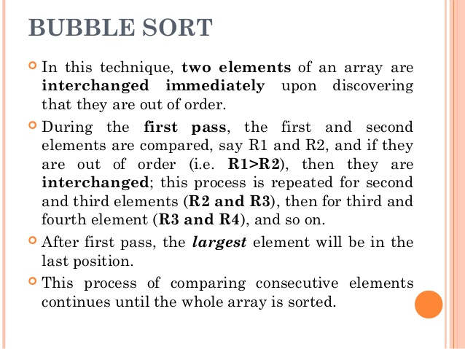

Slide 8
Algorithm of Bubble Sort
Repeat Steps 2 and 3 for K=1 to N-1
for(PTR:=1;PTR<=N-K;PTR++)
a. If A[PTR]>A[PTR+1]
then swap A[PTR] and A[PTR+1]
3. Exit

Slide 9
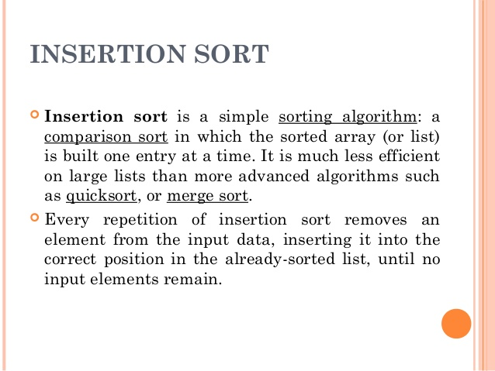

Slide 10
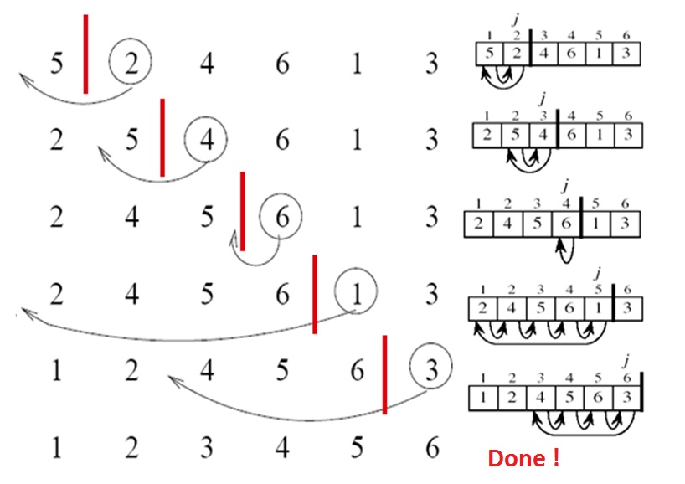
Insertion sort example

Slide 11
Algorithm of insertion sort
Int i, j,key;
For(i=1;i<n;i++)
{
key=a[i];
j=i-1;
while(j>=0 && a[j]>key)
{
a[j+1]=a[j];
j=j-1;
}
a[j+1]=key;
}

Slide 12
Merge Sort
while(i<n && j<m)
{
If(a[i]<b[j])
{c[k]=a[i]
k=k+1
i=i+1
}
else
{
c[k]=b[j]
k=k+1
j=j+1
}}
while(i<n)
c[k++]=a[i++]
while(j<m)
c[k++]=b[j++)

Slide 13
Selection Sort
for (i=0;i<n-1;i++)
{
Min=a[i];
Loc=i
for(j=i+1;j<n;j++)
{
if(a[j]<Min)
loc=j } }
Temp=a[i]
a[i]=a[loc]
a[loc]=Temp
}

